Slide 1

911-ASAP As Safe As Possible
Wontae (Kevin) Suh
Derek Francis
Anhua Wang

Slide 2

What does our application do? (Minimal Viable Product)
Store medical information about a client
One-touch instant 911 call
Immediately calls 911 when button is pressed
Sends user medical-records to 911 operator
Immediately notifies Next Of Kin that a call was made
(Families can come to the hospital in advanced for more info)

Slide 3

Unique Value Proposition
911 ASAP is a one-touch solution to instantly get in touch with the nearest hospital.
Instantly have all the information in hand for when the patient arrives
Acts as a personal medical database
“Instant and automated”

Slide 4

Differentiating Factors
Competitors does not have their design intuitive (widgets)
Competitors do not have all the important information in hand before the patients arrive
There are no user-friendly application to easily put down the medical information.

Slide 5
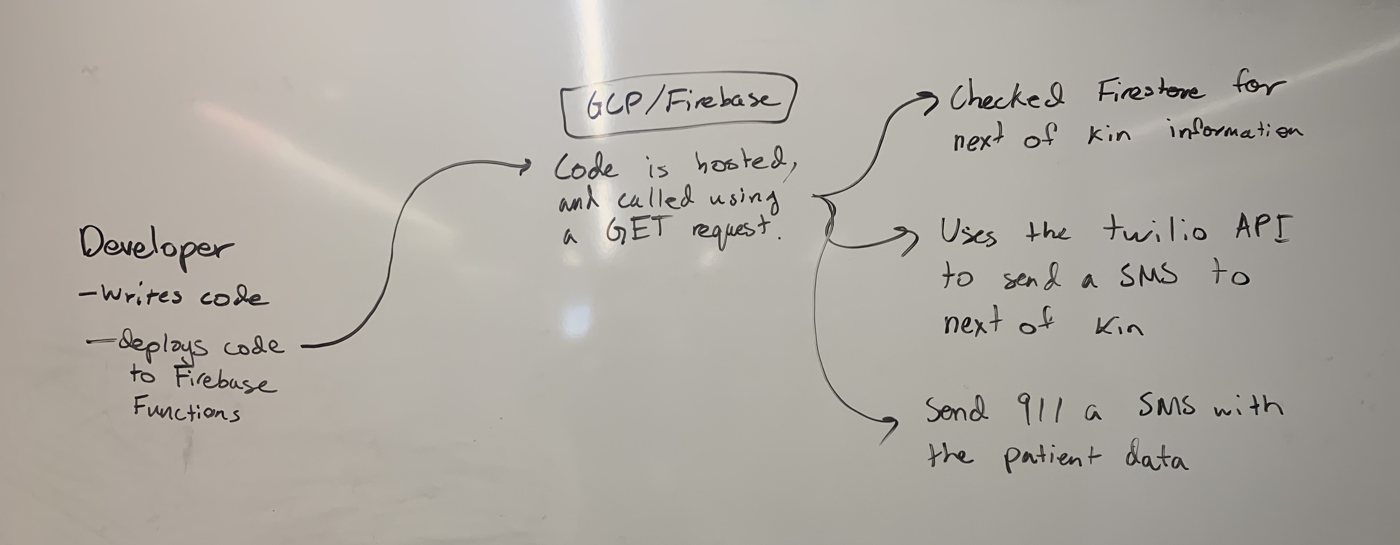
Demonstration

Slide 6
Website
https://www.student.cs.uwaterloo.ca/~a87wang/

Slide 7

Target Customer
Age: 18 – 84
Behavior:
Users who are prone to serious allergic reactions
Someone who is teach savvy
Elders who do not know much technology, easy access
Pain-point
Critical health conditions

Slide 8
Elevator Pitch
“An app that can save you instantly”

Slide 9

Business Plans
Market: Our target customer, medical centres, schools, parents of children who have severe medical conditions, children who have very old parents who live alone or who are very sick.

Slide 10
Business Plans
Revenue: Free to download to consumers but over the years have potential our goal is to develop partnerships with such services such that we work together symbiotical to improve their services and save lives.

Slide 11
Business Plans
Evolution of product offering:
- Smart watch / bracelet
- Mental health crisis.
- Suicide hotlines
- Campus Security.
- Reporting suspicious behavior.

